Slide 1

Ruby Language

Slide 2
About today…
Arrays / Hashes
Access
Modify
Iterate

Slide 3
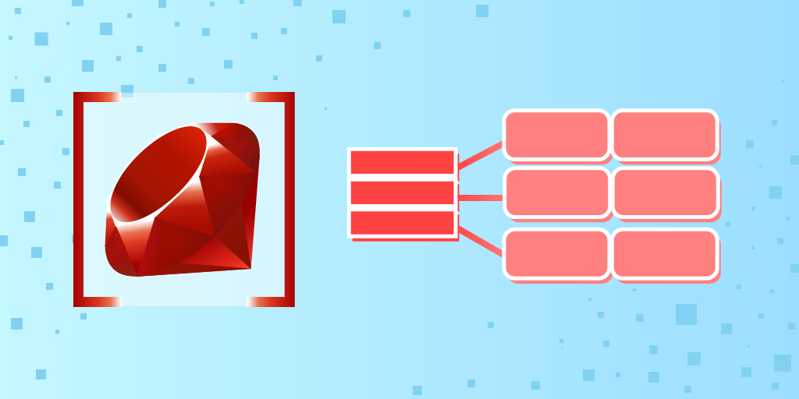
ARRAYS

Slide 4

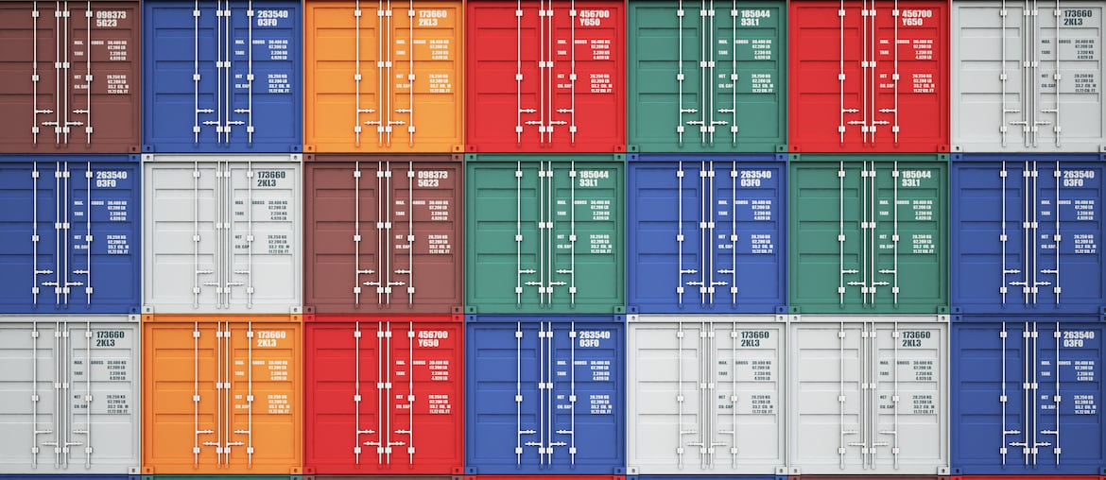
Introduction to Arrays
Arrays are ordered collections of objects
Elements in an array are indexed starting from 0

Slide 5



Accessing Arrays Elements

Slide 6





Modifying Arrays
Adding elements
Removing elements

Slide 7

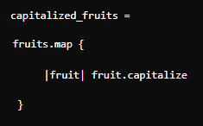
Iterating over Arrays
Using each
Using map

Slide 8




Common Array Methods

Slide 10
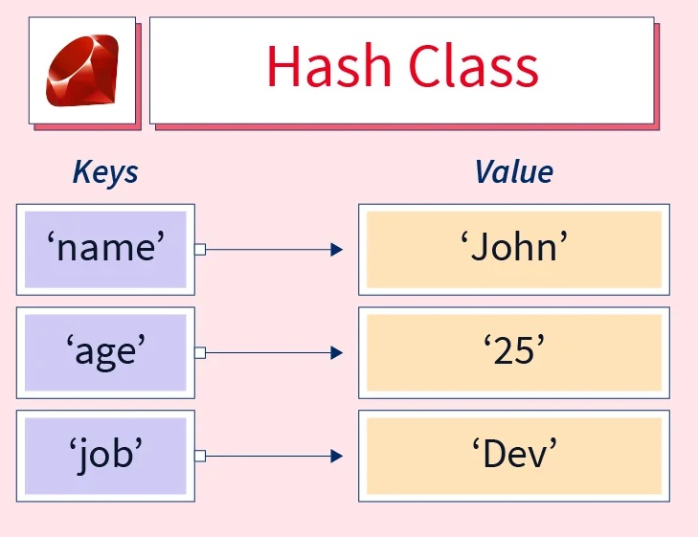

Introduction to Hashes
Hashes are collections of key-value pairs
Similar to dictionaries in other programming languages

Slide 11


Accessing Elements
Use keys to access values

Slide 12


Modifying Hashes
Adding key-value pairs
Updating values
Removing key-value pairs

Slide 13
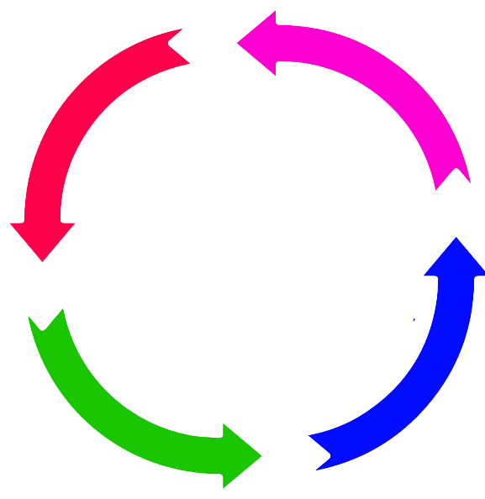

Iterating over Hashes
Using each
Using map

Slide 14




Common Hash Methods

Slide 15


Slide 16

How are elements accessed within an array?
How can you add a new element to the end of an array in Ruby?
How do you access the value associated with a specific key in a hash?
What method allows you to check if a key exists in a hash in Ruby?
How can you update the value of an existing key in a hash in Ruby?

Slide 17

Task 1
Create an array of your favorite colors, add a new color, remove the first color, and print the array's length
Task 2
Create a hash representing a book with keys: title, author, and pages, add a key genre, update the value of pages, and print all the keys of the hash

